Slide 1
Indonesian Abusive and Hate Speech Twitter Text
Roy Noviantho
DSC220900067

Slide 2
About what?
“Anjing lu”, “memang komunis”, “goblok” and many more. All these words are often heard or read in our daily life. Can be normal thing, but wait? Even if it’s just words it can be trigger an accident. From here, let’s see how can a sentence or just a word become hate speech up to abusive and divided into many categories ☺.

Slide 3
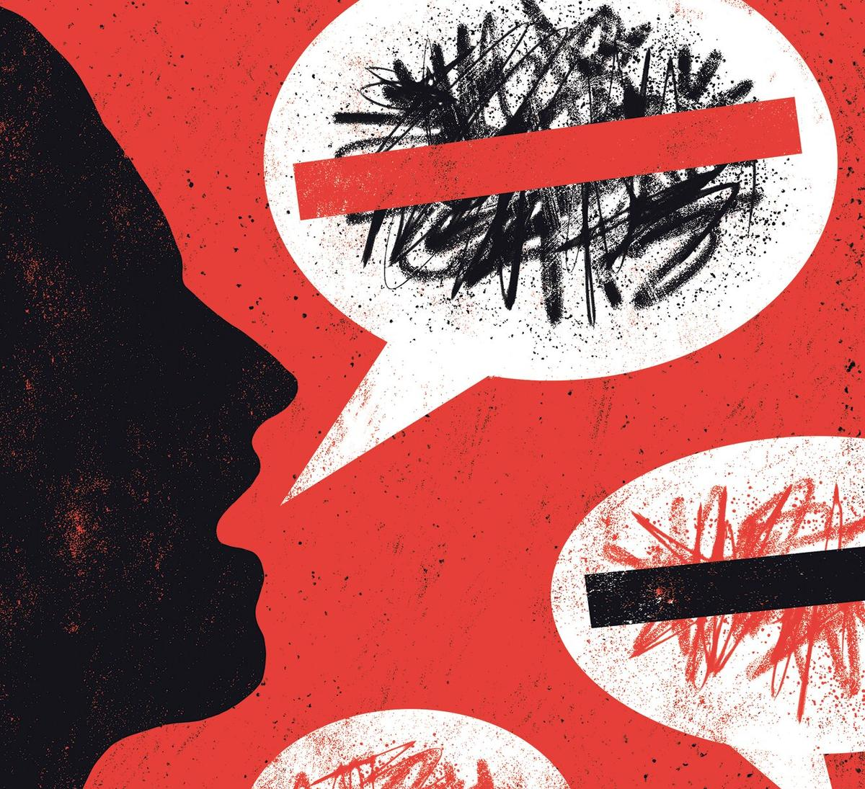

Dictionary
Hate Speech
Is a direct or indirect speech toward a person or group contained hatred based on something inherent to that person or group (Komnas HAM, 2015)
Abusive Words
Is an utterance that contains abusive words/phrases that is conveyed to the interlocutor (individuals / groups) both verbally and in writing.

Slide 4
Use this data please ☺
Out of there, there are already a lot of datasets about abusive or hate speech but why use this datasets? because
Using Indonesian Language
Not only detecting, but also classifying
And, It’s FREEEEE, you can also contribute
CONTRIBUTION FROM THIS DATA
Analyzing the target category and level of hate speech
Building a dataset for hate speech and abusive language
Conducting preliminaries experiments on multi-label hate speech and abusive language detection in Indonesian

Slide 5
Research methodology

Slide 6
How it’s works?
1
2
3
4
Used hate speech and abusive language Twitter dataset from several previous researches
Crawled tweets in order to enrich dataset using Twitter API
Two phases of annotation process. First phase annotation process was done to annotate the Twitter data whether tweets are hate speech and abusive language
Second phase annotation process was done to annotate the hate speech target, categories and level

Slide 7
So how’s the result?

Slide 8
REPORT ABOUT WHAT?
Type Sentence
Target Sentence
Categorical Sentence
Level Sentence
How many sentences are included into hate speech or abusive?
How many sentences are attacked individual or group?
How many sentences are divided into religion, race, physical or gender hate speech?
How many sentences based on level?

Slide 9
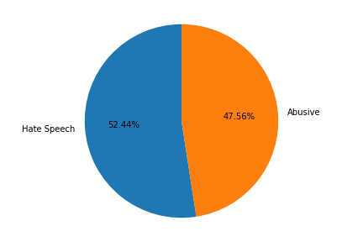
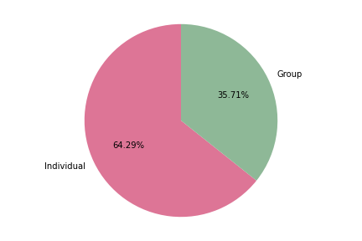
Type and target sentence
Chart Type Sentence
Chart Target Sentence
In the category of type sentence, the different between Hate Speech and Abusive it’s not too far. Can conclude that each hate speech is not necessarily an abusive word, vice versa but also sentence can contain hate speech and abusive word
Target individual is more dominating than group, because the data that used when during the election period in 2019, so it’s make sense if individual target more often appear for hate speech or abusive word

Slide 10
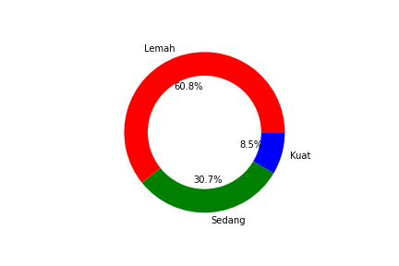
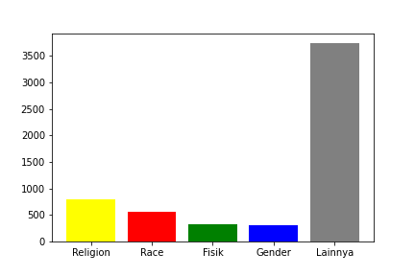
categorical and level sentence
Chart Categorical Sentence
Other categorical sentence it’s too damn high, but if you see between religion, race, physic and gender categorical hate speech the gap it’s not too far. Our people still use religion to do hate speech.
Chart Level Sentence
Usually people use twitter just as media to complain daily life or critics something, it’s carried away when deliver hate speech the level is low. Medium or strong level mostly done by a group that intentionally to bring down someone or group.

Slide 11
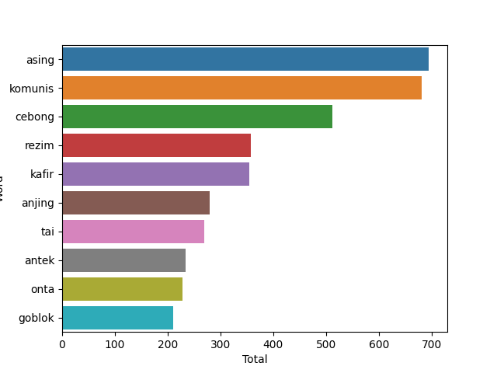
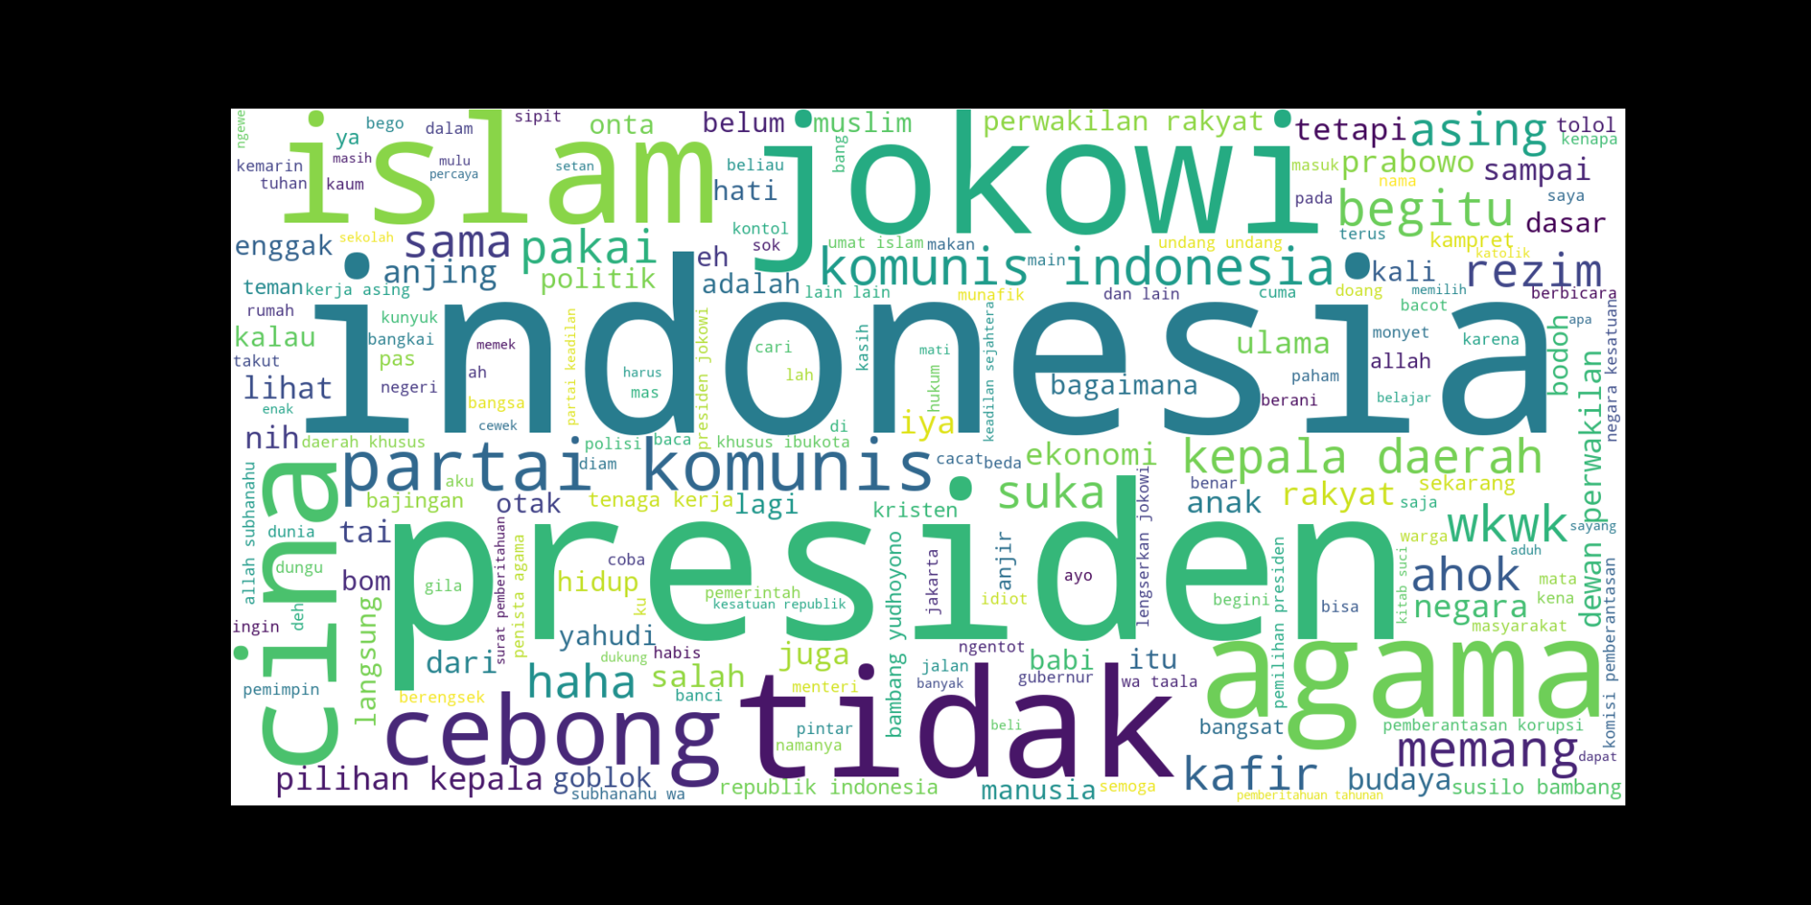
Can we get the top 10 of abusive word?
Absolutely yes we can. Here it is the top 10 of abusive word

Slide 12
SUMMARY
So, hate speech can contain abusive word or not but just to reminder that hate speech can classify into many categories like type, target, categorical and level by a sentence.
Last but not least, hate speech it’s totally different between critics, if you launch critics to someone or group it’s still okay but when contain hate speech, it’s not okay.

Slide 13
THANK YOU
Please be kind to each other ☺

